Slide 1
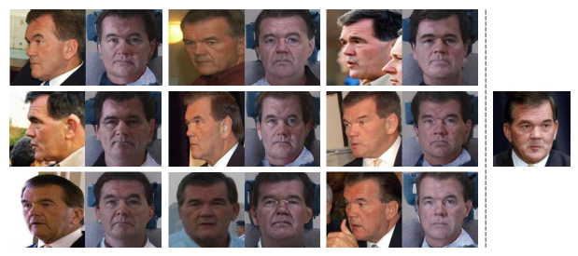
Unsupervised Face Normalization with Extreme Pose and Expression in the Wild
Qian, Y., Deng, W., & Hu, J. (2019). Unsupervised Face Normalization With Extreme Pose and Expression in the Wild. In Proceedings of the IEEE Conference on Computer Vision and Pattern Recognition (pp. 9851-9858).
Supervisor: Jun-Cheng Chen
Speaker: Yu-Ju Ku
_{2019/10/18}

Slide 2
Introduction
Problems:
Large pose, expression and lighting remain main obstacles for further pushing unconstrained face recognition
Difficulties of face rotation in unconstrained environment :
Complex face variations besides pose
Unpaired data
Goal:
Face normalization for unpaired data in unconstrained environment
Distill face identity and dispel face variances

Slide 3
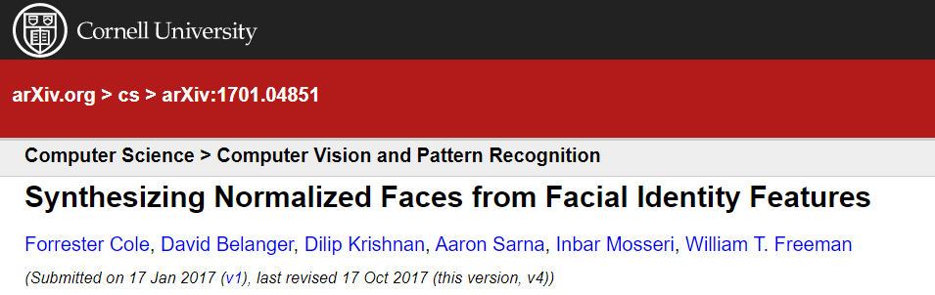
Face Normalization Model (FNM):
Completely based on neural network to solve the problems
Generative Adversarial Network (GAN[1]) –
synthesize normal face (target distribution) from non-normal face (source distribution)
Face expert network (VGG-Face2[2] )
Produce identity features
Keep identity
Identity features face image
Disadvantage –
Normalized faces are similar in outline but different in detail
map
https://arxiv.org/pdf/1701.04851.pdf [3]
[1] I. J. Goodfellow, J. Pouget-Abadie, M. Mirza, B. Xu, D. Warde-Farley, S. Ozair, A. Courville, and Y. Bengio. Generative adversarial nets. In International Conference on Neural Information Processing Systems, pages 2672–2680, 2014.
[2] Q. Cao, L. Shen, W. Xie, O. M. Parkhi, and A. Zisserman. Vggface2: A dataset for recognising faces across pose and age. 2017.
[3] F. Cole, D. Belanger, D. Krishnan, A. Sarna, I. Mosseri, and W. T. Freeman. Synthesizing normalized faces from facial identity features. In IEEE Conference on Computer Vision and Pattern Recognition, pages 3386–3395, 2017.
Notes:
Identity feature 人體特徵
表現好的 features similarity of normalized face and input face, it can keep the identity of
face during the transformation
Normalized faces are similar in outline but different in detail, so the generator’s task is arduous without paired data

Slide 4
Modification
Pixel-wise loss (for unpaired data problem):
By normal face reconstruct
Image content consistency
Stabilizes the training process in unsupervised face normalization.
Face attention mechanism:
Refine local texture
A series of attention discriminators in the fixed area of generated normalized faces
Notes:
First, we introduce a new term of pixel-wise loss in unpaired data problem.
When the generator reconstructs normal face to itself, a pixel-wise loss could be applied to stabilize the optimization process.
Second, face attention mechanism is proposed to refine local facial texture.
Without any assistant techniques (e.g., 3D face model and landmark localization), our face attention model is simple but effective.
Unlike previous methods that crop local areas of input face with landmark localization, we construct a series of attention discriminators in the fixed areas of generated normalized face. With the prior knowledge of facial attribute, attention discriminators would automatically enhance the quality of local facial texture.

Slide 5
Related works
GAN[1]
Face normalization
3D face model [4]
3DMM [5]
FF GAN [6]
Two-Pathway Generative Adversarial Network (TP-GAN) [7]
Pose Invariant Model (PIM) [8]
[4] T. Hassner, S. Harel, E. Paz, and R. Enbar. Effective face frontalization in unconstrained images. pages 4295–4304, 2014.
[5] X. Zhu, Z. Lei, J. Yan, Y. Dong, and S. Z. Li. High-fidelity pose and expression normalization for face recognition in the wild. In Computer Vision and Pattern Recognition, pages 787–796, 2015.
[6] X. Yin, X. Yu, K. Sohn, X. Liu, and M. Chandraker. Towards large-pose face frontalization in the wild. In ICCV, 2017.
[7] R. Huang, S. Zhang, T. Li, and R. He. Beyond face rotation: Global and local perception gan for photorealistic and identity preserving frontal view synthesis. In ICCV, pages 2458–2467, 2017.
[8] J. Zhao, Y. Cheng, Y. Xu, L. Xiong, J. Li, F. Zhao, K. Jayashree, S. Pranata, S. Shen, and J. Xing. Towards pose invariant face recognition in the wild. In CVPR, 2018.
Notes:
Conditional GAN (Mirza and Osindero):
Control the generator and discriminator for effective image-to-image generating
Wasserstein GAN (WGAN, Arjovsky et al):
Wassertain distance makes progress toward stable training of GANs.
3D face model (Hassner et al.):
Register and produce frontal face
3DMM (Zhu et al.):
High fidelity pose and expression normalization method
FF GAN
TP-GAN
PIM

Slide 6
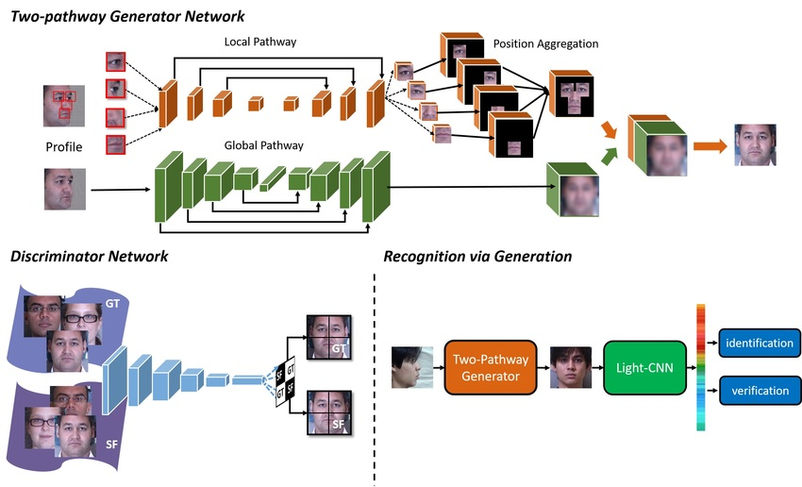
TP-GAN[6]

Slide 7
Proposed method
Generative Adversarial Network (GAN)[1]
Face expert network (VGG-Face2)[2]
Pixel-wise loss
Face attention mechanism

Slide 8
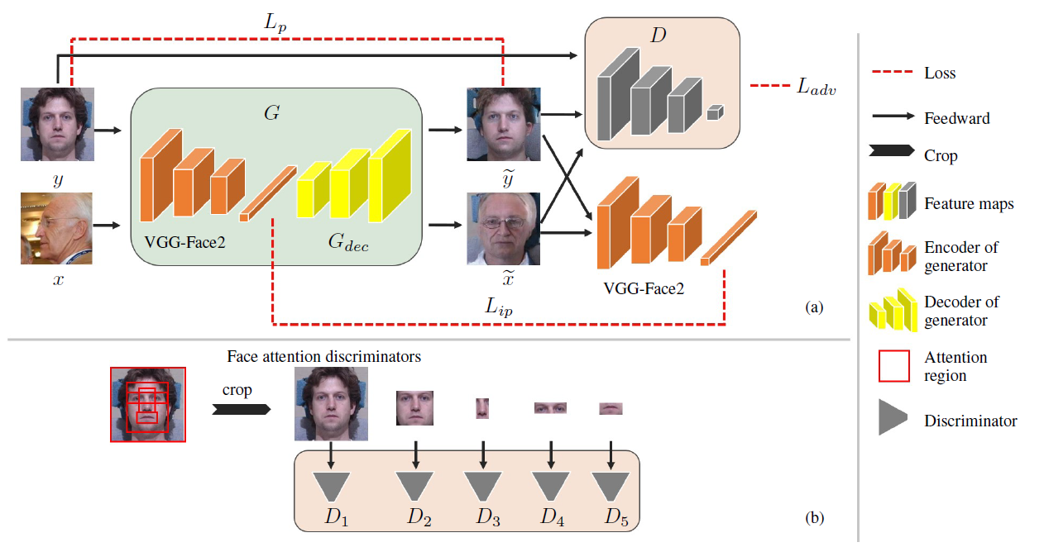
Proposed method
Feed-forward net
Attention discriminators
Notes:
(a)為前饋神經網路

Slide 9
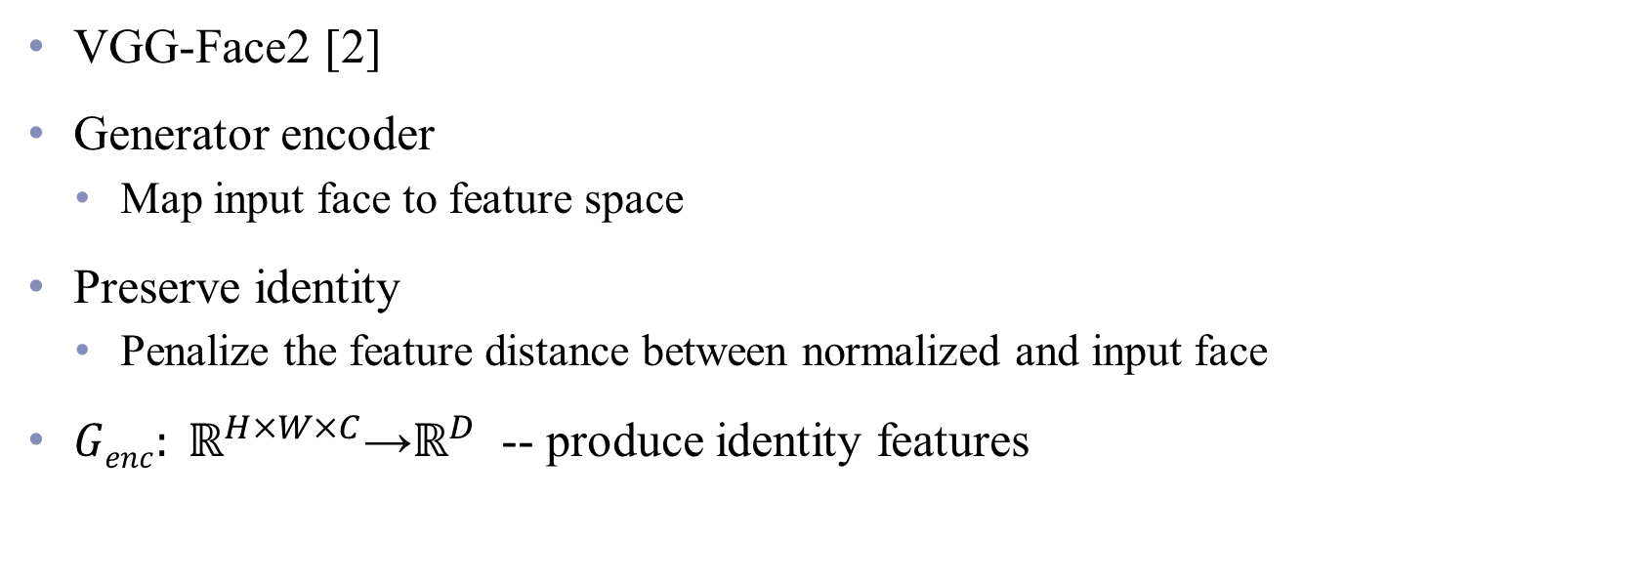
Face export net
VGG-Face2 [2]
Generator encoder
Map input face to feature space
Preserve identity
Penalize the feature distance between normalized and input face
${Genc: ℝ}^{H×W×C}\text{→}ℝ^{D}$ -- produce identity features
Notes:
Most previous works only use face model to maintain perceptual similarity of generated face and input face.
In our model, face recognition network is also used as encoder network to initially
distill identity information and dispell non-identity information.
we employ a publicly-available face expert network, VGG-Face2 [4] network,
both as the encoder of generator Genc and as a source of identity loss.
Our assumption is that the face expert network is a strong prior knowledge on face recognition.
In response, we keep the face expert network fixed and do not update its parameters during training.
For preserving face identity,
we penalize the feature distance between normalized face and input face.
Both employed in generator and used for identity preserving, the face expert network
where H, W, and C denote the image height, width, and channel number respectively,
and D is the size of feature vector.

Slide 10
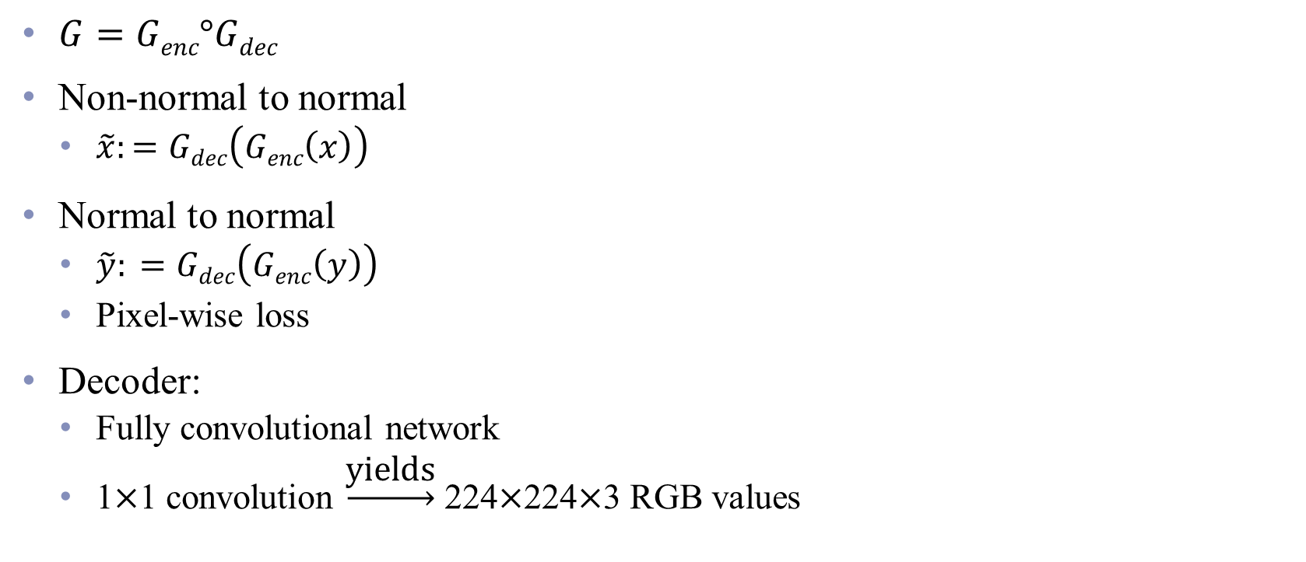
Generator
$G=Genc°Gdec$
Non-normal to normal
$\tilde{x}:=Gdec\left(Genc\left(x\right)\right)$
Normal to normal
$\tilde{y}: =Gdec\left(Genc\left(y\right)\right)$
Pixel-wise loss
Decoder:
Fully convolutional network
1×1 convolution $\underset{→}{\text{yields}}$ 224×224×3 RGB values
Notes:
Gdec is constructed to make a further effort on
distilling identity by recovering a normalized face.
Term of normal-to-normal mapping can introduce pixel-wise loss,
which guides and stabilizes the optimization of GAN in condition of unpaired data.
Gdec包含了多層
(transposed convolution layer [9], ReLU layer and Residual block [14])
Meanwhile, preserving the identity information is crucial for face recognition.
Employing face expert network in generator is an essential part in our model.

Slide 11
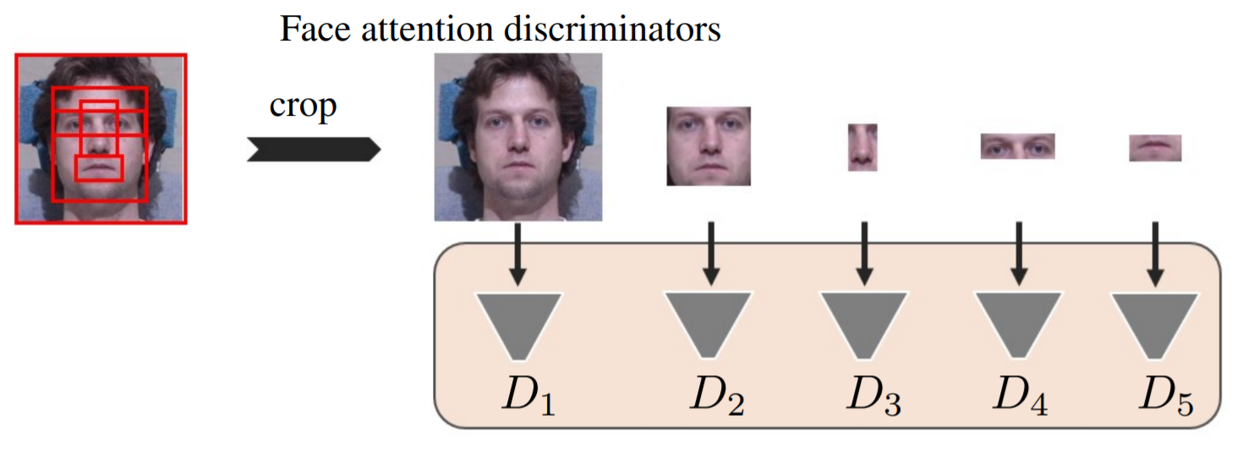
Face attention discriminators
Distinguish between real and generated normal face images
Local facial texture
Notes:
crop the regions of eyes, nose, mouth and face to construct face attention discriminators, (D2-D5)
while an addition discriminator receives the entire image.(D1)
Different from general image generation task, face synthesis attaches great importance to local facial texture.
Unlike previous works that crop attention regions of input image, our FNM pays attention on fixed regions of output normalized face.

Slide 12
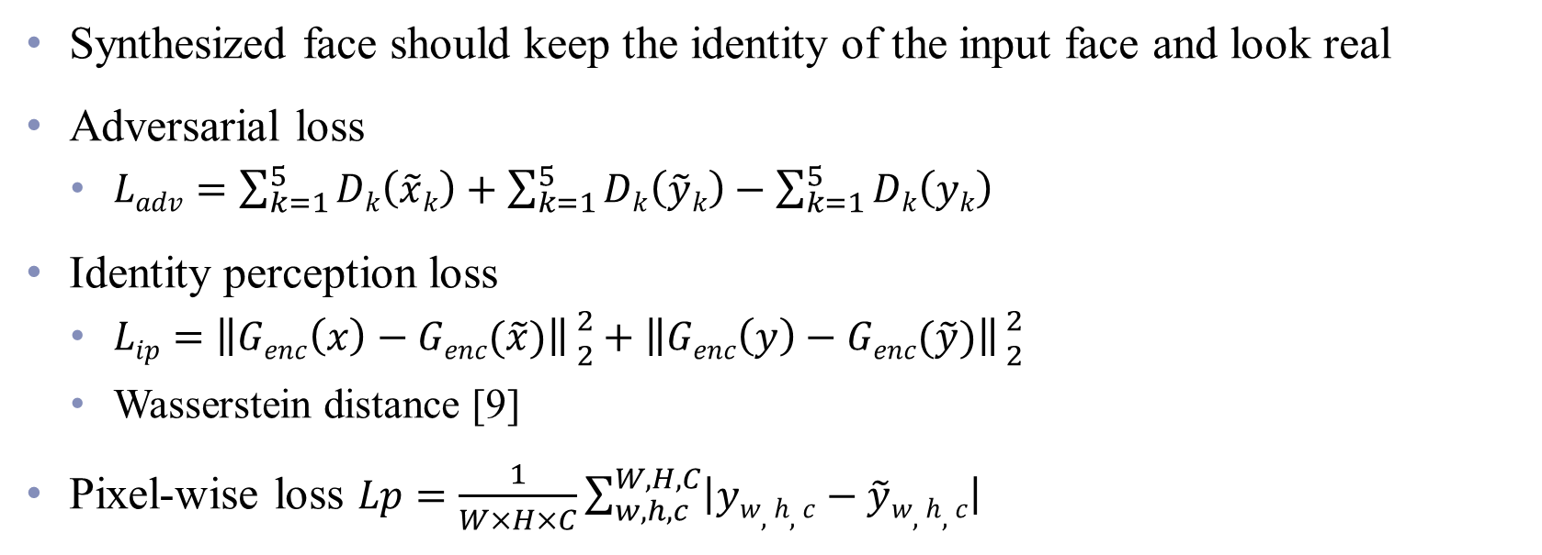
Loss function
Synthesized face should keep the identity of the input face and look real
Adversarial loss
$Ladv=\sum_{k=1}^{5}{Dk\left(\tilde{x}k\right)}+\sum_{k=1}^{5}{Dk\left(\tilde{y}k\right)}−\sum_{k=1}^{5}{Dk\left(yk\right)}$
Identity perception loss
$Lip=\left\|Genc\left(x\right)−Genc(\tilde{x})\right\|{2 \atop 2}+\left\|Genc\left(y\right)−Genc(\tilde{y})\right\|{2 \atop 2}$
Wasserstein distance [9]
Pixel-wise loss $Lp=\frac{1}{W×H×C}\sum_{w, h, c}^{W, H, C}{\left|yw, h, c−\tilde{y}w, h, c\right|}$
[9] I. Gulrajani, F. Ahmed, M. Arjovsky, V. Dumoulin, and A. Courville. Improved training of wasserstein gans. 2017.
Notes:
Adversarial loss, for domain adaptation from source distribution (i.e., nonnormal face set)
to target distribution (i.e., normal face set) and
adding realism to the synthesized images
Identity perception loss, for preserving the identity information
Proposed by Arjovsky et al. [2], Wasserstein distance is effective in stabilizing the optimization process of GAN.
We apply WGAN-GP [12] loss in our model instead of original cross entropy loss.
To be specific, the outputs of the discriminators are directly applied to loss function without sigmoid activating.
比標準 WGAN擁有更快的收斂速度，並能生成更高質量的樣本
提供穩定的 GAN訓練方式，幾乎不需要怎麼調參，成功訓練多種針對圖片生成和語言模型的 GAN架構
-判別器最後一層去掉 sigmoid
-生成器和判別器的 loss不取log
-對更新後的權重強制截斷到一定範圍內，比如 [-0.01，0.01]，以滿足論文中提到的lipschitz 連續性條件
-以上一切好處不需要精心設計的網絡架構，最簡單的多層全連接網絡就可以做到
-WGAN理論上給出了GAN訓練不穩定的原因，即交叉熵（JS散度）不適合衡量具有不相交部分的分佈之間的距離，轉而使用wassertein距離去衡量生成數據分佈和真實數據分佈之間的距離，理論上解決了訓練不穩定的問題
-解決了模式崩潰的（ collapse mode）問題，生成結果多樣性更豐富
-對 GAN的訓練提供了一個指標，此指標數值越小，表示GAN訓練的越差，反之越好。可以說之前訓練GAN完全就和買彩票一樣，訓練好了算你中獎，沒中獎也不要氣餒，多買幾注吧
The image-wise adversarial loss would result in distorted face contour and volatile optimization process.
We would like the generator G to behave like an identity matrix when applied to faces from the normal set.
It is an essential part for both texture information preserving and stable optimization.
We introduce a pixel-wise consistency before and after face normalization on normal face, denoted by Lp

Slide 13
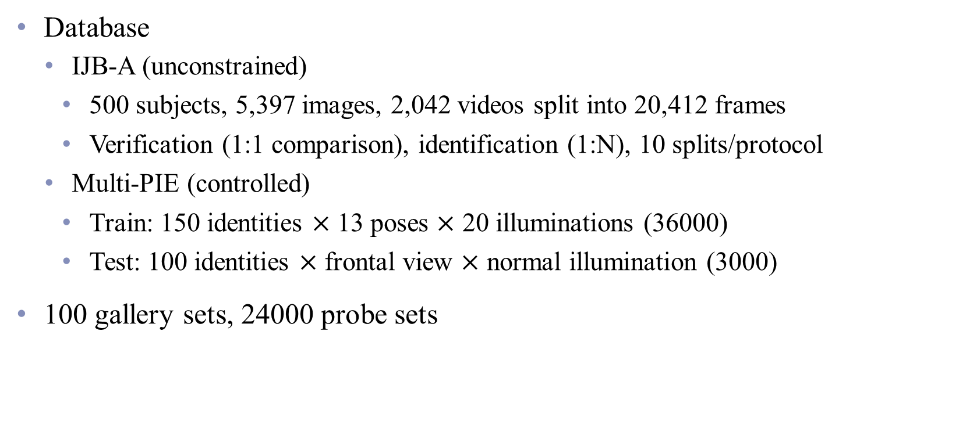
Experimental settings
Database
IJB-A (unconstrained)
500 subjects, 5,397 images, 2,042 videos split into 20,412 frames
Verification (1:1 comparison), identification (1:N), 10 splits/protocol
Multi-PIE (controlled)
Train: 150 identities $×$ 13 poses $×$ 20 illuminations (36000)
Test: 100 identities $×$ frontal view $×$ normal illumination (3000)
100 gallery sets, 24000 probe sets
[10] B. F. Klare, B. Klein, E. Taborsky, A. Blanton, J. Cheney, K. Allen, P. Grother, A. Mah, and A. K. Jain. Pushing the frontiers of unconstrained face detection and recognition: Iarpa janus benchmark a. In Proceedings of the IEEE Conference on Computer Vision and Pattern Recognition, pages 1931–1939, 2015.
[11] R. Gross, I. Matthews, J. Cohn, T. Kanade, and S. Baker. Multi-pie. Image and Vision Computing, 28(5):807–813, 2010.
Notes:
所提供的臉部影像依慣例分成
註冊組 (Gallery Set) 建立臉部模型之用
搜尋組 (Probe Set) 測試之用，後者所含的個體不僅包括前者即註冊組 (Gallery set) 中的所有個體外，尚包含許多未參與註冊的個體。

Slide 14
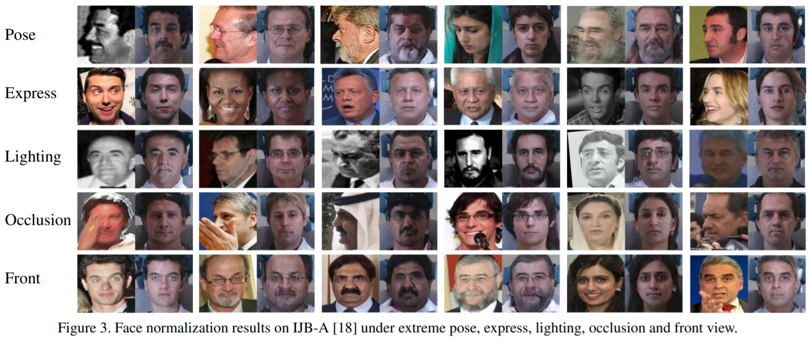
Qualitative results

Slide 15
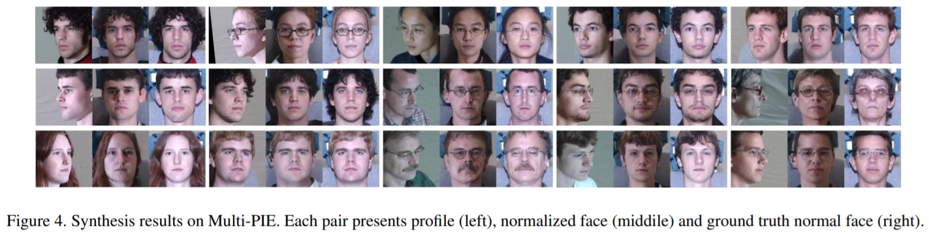
Qualitative results

Slide 16
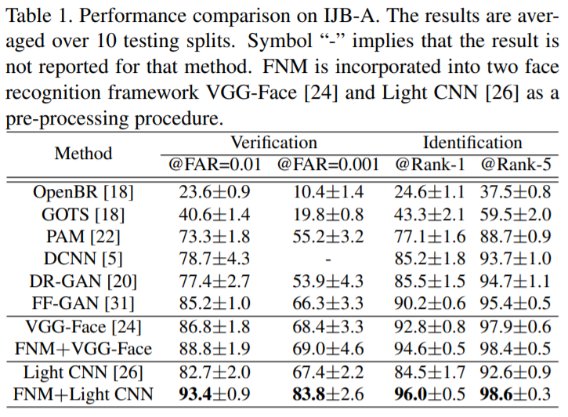
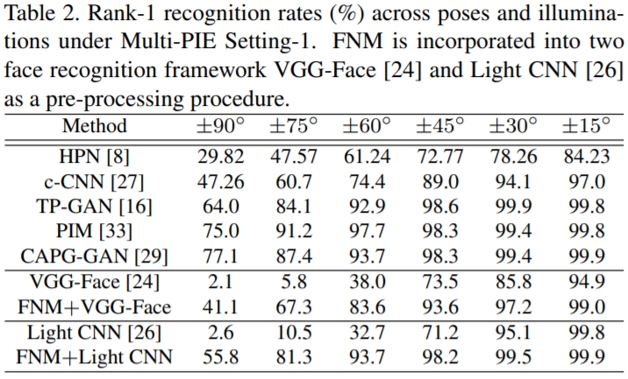
Quantitative results
Notes:
FNM is incorporated into two pre-trained face recognition models, VGGFace [24] and Light CNN [26].
We use FNM as a pre-processing procedure and then apply the same face recognition process.
In Table 1, we evaluate the face recognition performance on our normalized images of IJB-A database with two baselines and other state-of-the-art methods.
The results of VGG-Face [24] and Light CNN [26] demonstrate that FNM has a clear advantage to enhance the performance of face recognition model.
FNM with Light CNN achives 10.7% improvement at FAR 0.01
and 16.4% improvement at FAR 0.001 on face verification
7.5% improvement at Rank-1
and 6.0% improvement at Rank-5 on identification
The performance gap with the other methods lies in two points:
1)These methods fine-tune the baseline (Light-CNN) on the Multi-PIE database,
while our FNM is directly incorporated to face recognition model;
2) These methods train with paired data and identity information,
while our FNM keeps the same training strategy with uncontrolled

Slide 17
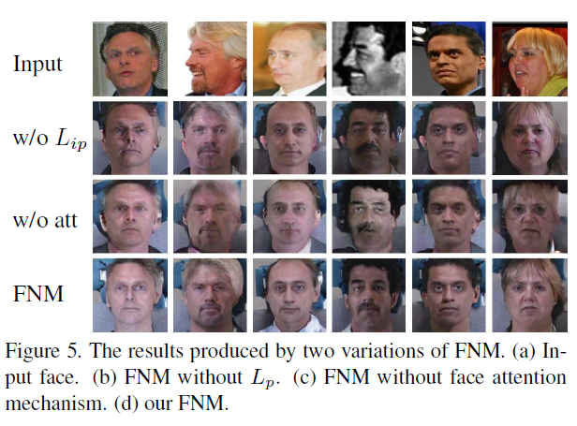
Ablation study
Notes:
FNM is incorporated into two pre-trained face recognition models, VGGFace [24] and Light CNN [26].
We use FNM as a pre-processing procedure and then apply the same face recognition process.
In Table 1, we evaluate the face recognition performance on our normalized images of IJB-A database with two baselines and other state-of-the-art methods.
The results of VGG-Face [24] and Light CNN [26] demonstrate that FNM has a clear advantage to enhance the performance of face recognition model.
FNM with Light CNN achives 10.7% improvement at FAR 0.01
and 16.4% improvement at FAR 0.001 on face verification
7.5% improvement at Rank-1
and 6.0% improvement at Rank-5 on identification
The performance gap with the other methods lies in two points:
1)These methods fine-tune the baseline (Light-CNN) on the Multi-PIE database,
while our FNM is directly incorporated to face recognition model;
2) These methods train with paired data and identity information,
while our FNM keeps the same training strategy with uncontrolled

Slide 18
Conclusions
Face Normalization Model (FNM) for unsupervised face normalization in condition of unconstrained environment
Face expert network
Pixel-wise loss
Face attention mechanism
Advantage
Easily incorporated into off-the-shelf face recognition framework
Notes:
Face expert network:
Produce face identity features
Preserve identity→generator employ high-level semantic feature instead of image
Pixel-wise loss
Stabilizing training optimization and high quality result
Face attention mechanism
Refine local texture

Slide 19
Thanks for listening!

